Slide 1
Capstone Project “Battle of Neighborhoods”
“Recommending Hospital need in the near vicinity of high prone Accident Areas”
Presented by : Deepen Virani
Published on : October 2018

Slide 2
Index _______________________________________________________________
Business Problem / Goal
Data
Methodology
Results
Discussion Section
Conclusion
References
Acknowledgement

Slide 3

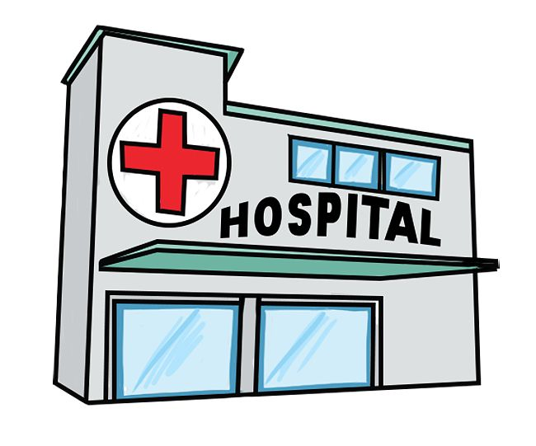
Business Problem / GOAL _______________________________________________
Business Problem:
High rise in road accidents and lack of Medical centers/ hospitals in nearby vicinities increases the risk of rise in death tolls.
Our Goal:
To build an application which takes any given location as input.
Identifies high accident zones in that area.
Analyzes and checks availability of adequate number of hospitals in
nearby range to those locations.
Recommend to open a new Hospital incase of non availability or less
numbers of hospitals are present.

Slide 4
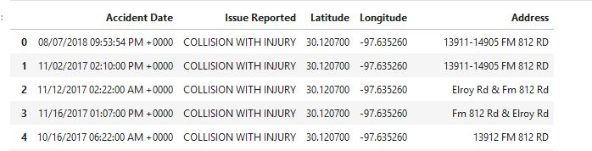
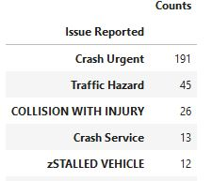
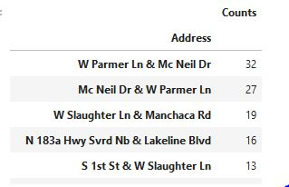
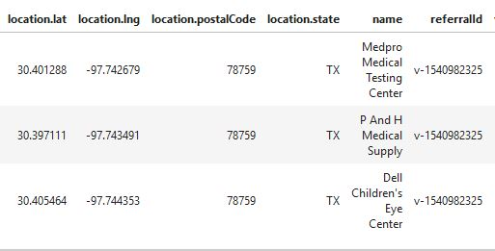
Accident Data source: data set on daily basis from website : https://catalog.data.gov/dataset/traffic-reports Hospital locations data source: FOURsquare api DATA: https://foursquare.com/
DATA _______________________________________________________________

Slide 5





methodology _______________________________________________________________
Download the accident data from the website for desired city / state and using the python pandas store it into the dataframe.
Keep the desired columns fields in the dataframe and exclude unwanted / incomplete data entries.
Identify top accident spots (coordinates) based on number of occurrence of accidents.
Check hospitals / medical centers for these coordinates in Foursquare ‘Search’ API.
Set a minimum number of hospitals to be present near to accident zones.
If number of hospitals < minimum threshold limit, recommend to open a new hospital.
Repeat the steps for each accident spot in top list.

Slide 6
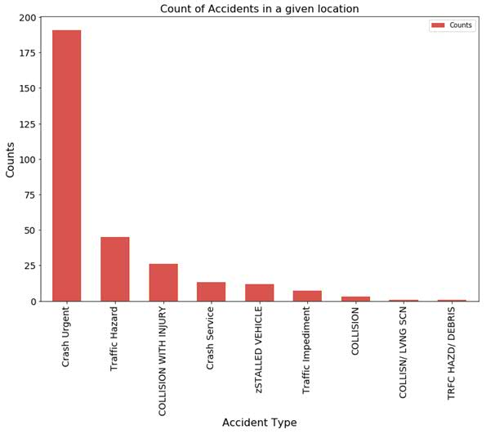
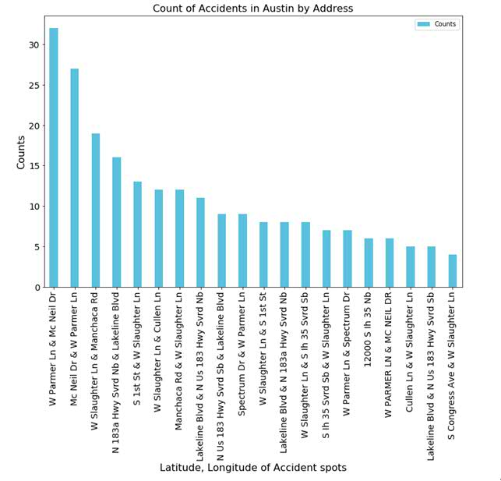
analysis / results ___________________________________________________________________
Accident types wise counts plot:
Address wise counts and its Bar plot

Slide 7
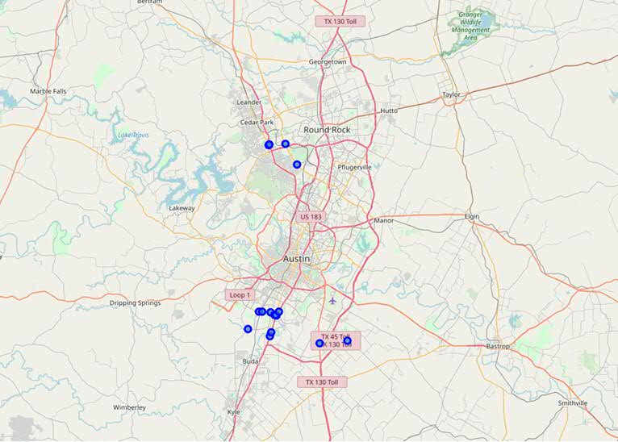
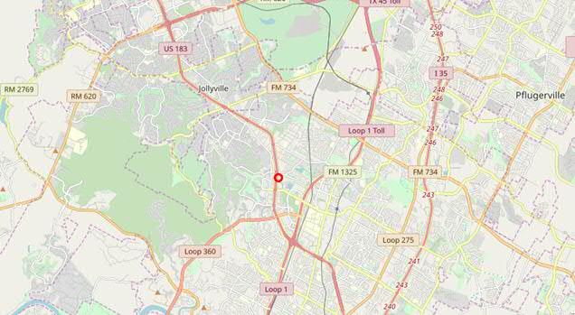
analysis / results (ConTD..) ___________________________________________________________________
30.2711286
30.2711286
Accident spots in the map of Austin, Texas
based on data set mentioned in Data slides.
Existing Hospital spots in the map of Austin, Texas
based on data set mentioned in Data slides. (eg:
Latitude = 30.2711
Longitude = -97.7436

Slide 8
analysis / results (ConTD..) ___________________________________________________________________
30.2711286
30.2711286
In this model I have considered only the top most accident zone in Austin, TX for analysis.
As a result of this process, I got the location corresponding to the high prone accident zones vicinity where there is a need of medical centers.
Alternatively, this model can be enhanced to consider top 10 or more such locations where there is a need of a new medical centers.
Alternatively this model and its results could be used for restructuring or improving the zone / location where large number of accidents happens.
Users for this project/model could be individuals, pvt. organizations/firms who are planning to open a new hospital of medical center.
It can also be used to alert government authorities to recommend opening a new hospital in any location.

Slide 9
references _______________________________________________________________
Accident data sources: https://catalog.data.gov/dataset/traffic-reports
Maintainer Email: transportation.data@austintexas.gov
Foursquare APIs : https://foursquare.com/ , https://api.foursquare.com/v2/
Jupyter notebook (actual code): Capstone_Project.ipynb

Slide 10
THANK YOU!

